Slide 1
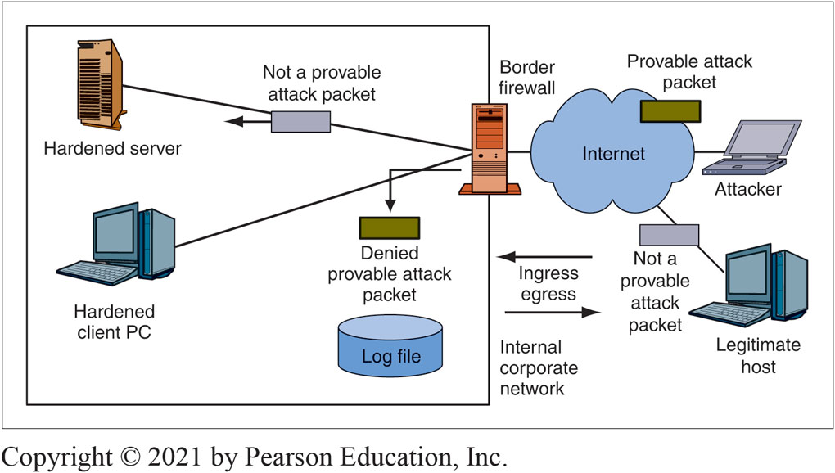
Figure 6-1: Basic Firewall Operation
Notes:
This figure shows that a firewall examines each packet passing through it. If the packet is a provable attack packet, the firewall drops the packet. If the packet is not a provable attack packet, the firewall passes the packet on to its destination. In firewalls, this is called a pass/deny decision.

Slide 2
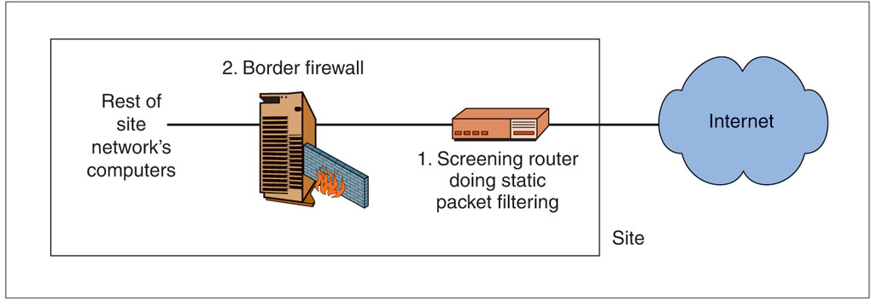
Figure 6-4: Main Border Firewall and Screening Router That Uses Static Packet Filtering
Stops simple, high-volume attacks to reduce the load on the main border firewall
6-2

Slide 3
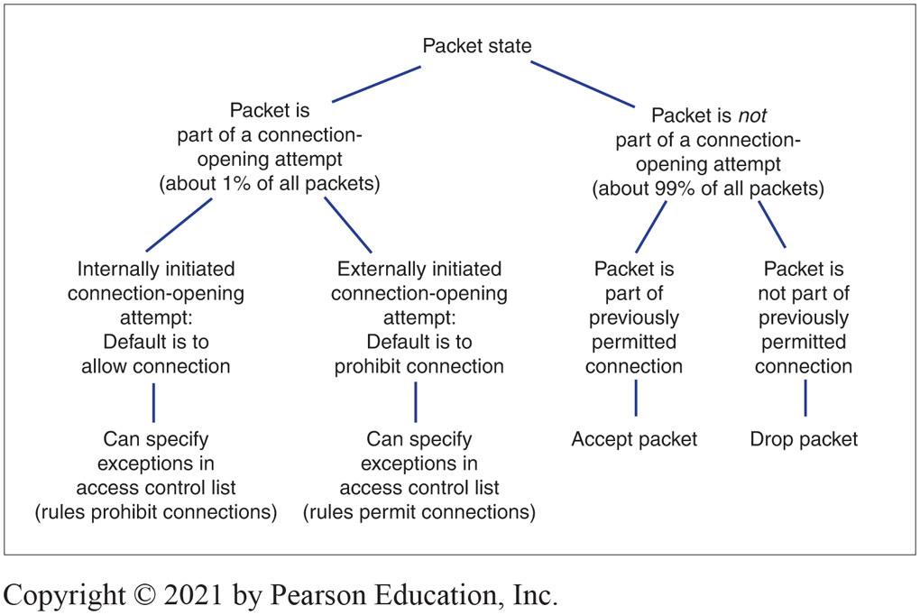
Figure 6-5: States in a Connection
Nearly all corporate border firewalls today use the stateful packet inspection (SPI) filtering method rather than static filtering
SPI focuses on connections: Persistent conversations between different programs on different computers
6-3
Notes:
The concept of states is central to SPI filtering. Figure 6-5 illustrates a simple connection in which there are only two states.
First, there is an opening state, when the two applications agree to open a connection.
Afterward, the two applications enter the ongoing communication state. For most connections, traffic is dominated by exchanges during the ongoing communication state. The two applications communicate back and forth using the same port numbers and other conditions.

Slide 4
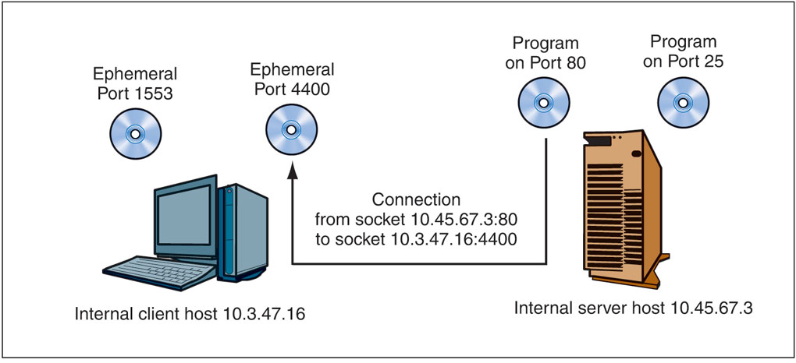
Figure 6-6: Connection and Socket
Notes:
SPI focuses on connections between programs on different hosts. In networking, a connection is represented by its socket, which designates a specific program (designated by a port number) on a specific computer (IP address). A socket is written as an IP address, a colon, and a port number—for example, 10.3.47.16:4400. As Figure 6-6 shows, a connection is a link between programs on different machines. It consists of two sockets—an internal socket and an external socket.

Slide 5
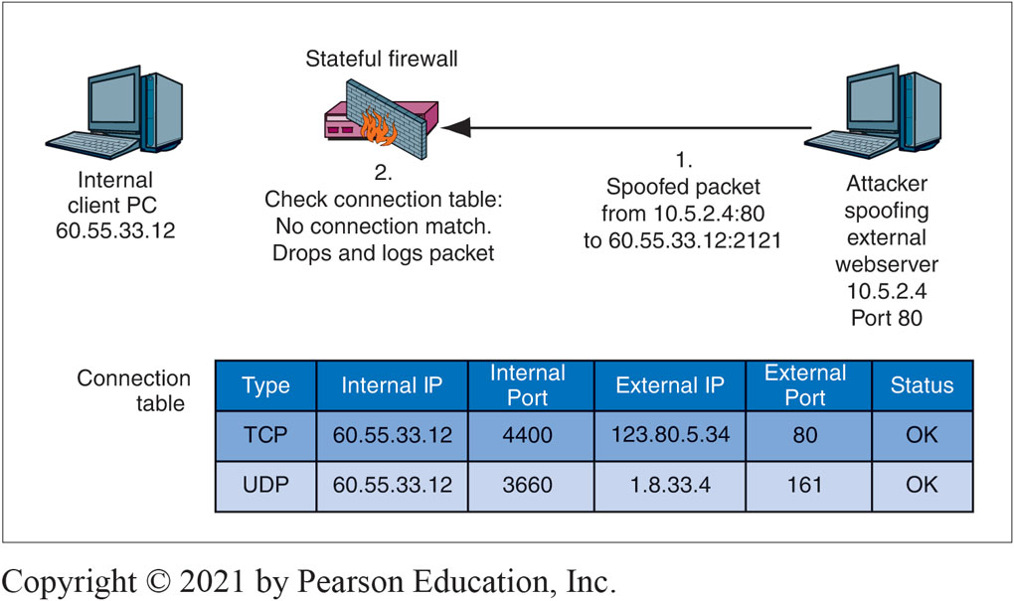
Figure 6-8: Stateful Packet Inspection for a Packet That Does Not Attempt to Open a Connection II
Notes:
Suppose that an attacker’s host sends a packet with the IP source address 10.5.2.4 (a spoofed IP address) and the TCP destination port 80. This is not a connection-opening attempt. (The SYN flag is not set in the TCP segment.) In Figure 6-8, we see that this packet does not match any row in the connection table. The firewall drops and logs the packet.

Slide 6
Stateful Packet Inspection: Access Control Lists (ACL)
An ACL is a series of rules for allowing or disallowing connections
The rules are executed in order, beginning with the first
If a rule does not apply to the connection-opening attempt, the firewall goes to the next ACL rule
If the rule does apply, the firewall follows the rule, and no further rules are executed
If the firewall reaches the last rule in the ACL, it follows that rule
6-6

Slide 7
Simple Ingress ACL
If TCP destination port = 80 or TCP destination port = 443, then Allow Connection [Permits connection to ALL internal webservers]
If TCP destination port = 25 AND IP destination address = 60.47.3.35, then Allow Connection [Permits connections to a SINGLE internal mail server]
Disallow ALL Connections [Disallows all other externally initiated connections; this is the default behavior]
Ingress ACL’s Purpose
The default behavior is to drop all attempts to open a connection from the outside
All ACL rules except for the last give exceptions to the default behavior under specified circumstances
The last rule applies the default behavior to all connection-opening attempts that are not allowed by earlier rules to be executed by this last rule
6-7

Slide 8
Stateful Packet Inspection -Benefits
Low Cost
Most packets are not part of packet-opening attempts
These can be handled very simply and therefore inexpensively
Connection-opening attempt packets are more expensive processes but are rare
Safety
Attacks other than application-level attacks usually fail to get through SPI firewalls
In addition, SPI firewalls can use other forms of filtering when needed
6-8

Slide 9
Application Proxy Firewalls and Content Filtering
Protections for Internal Clients against Malicious Webservers
URL blacklists for known attack sites
Protection against some or all scripts in webpages
The disallowing of HTTP response messages with prohibited MIME types that indicate malware
Protections against Misbehaving Internal Clients
Disallowing HTTP POST (the method can be used to send out sensitive files
Protections for Internal Webservers against Malicious Clients
Disallow HTTP POST methods, which could allow malware files to be placed on the server
Indications of SQL injection attacks
6-9
Notes:
Mime - Multipurpose Internet Mail Extensions is an Internet standard that extends the format of email messages to support text in character sets other than ASCII, as well as attachments of audio, video, images, and application programs.

Slide 10
Application Proxy Firewalls and Content Filtering (cont)
Automatic Protections
The hiding of internal host IP addresses from sniffers
Header destruction
The data link, internet, and transport headers are discarded—along with any attacks they may have contained
Protocol fidelity
If the client or server does not follow the protocol of the indicated port number, communication with the firewall automatically breaks down
6-10

Slide 11
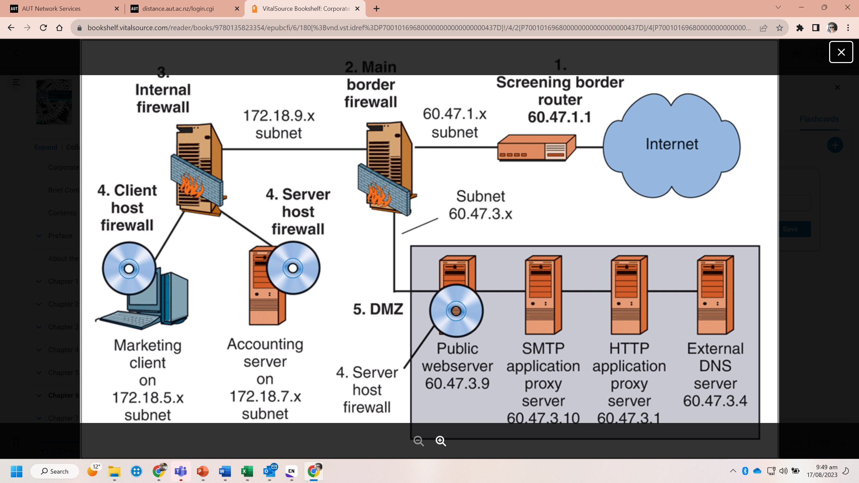
Fig 6-20. Firewall architecture

Slide 12
Intrusion Detection Systems
Intrusion Detection Systems (IDSs)
Firewalls drop provable attack packets only
Intrusion detection systems (IDSs) look for suspicious traffic
Sends an alarm message if the attack appears to be serious
Problem: Too many false positives (false alarms)
Problem: Heavy processing requirements because of sophisticated filtering
Packet stream analysis
Often, patterns cannot be seen unless many packets are examined
6-12

Slide 13
Intrusion Prevention Systems
Intrusion Prevention Systems (IPSs)
Use IDS filtering mechanisms
Application-specific integrated circuits (ASICs) provide the needed processing power
Attack identification confidence spectrum
Somewhat likely
Very likely
Provable
Allowed to stop traffic at the high end of the confidence spectrum
Management decides which attacks to stop
6-13

Slide 14
Firewall Filtering Problems
Most Filtering Methods Use Attack Signature Detection
Each attack has a signature .This attack signature is discovered. The attack signature is added to the firewall
Problem
Zero-day attacks are attacks without warning, and occur before a signature is developed. Signature defense cannot stop zero-day attacks
Anomaly Detection
Detects an unusual pattern indicating a possible attack. This is difficult, so there are many false positive occurrences. Anomaly detection is necessary in today’s firewalls
6-14

Slide 15
Enter AI
Dawadi, B. R., Adhikari, B., & Srivastava, D. K. (2023). Deep Learning Technique-Enabled Web Application Firewall for the Detection of Web Attacks. Sensors, 23(4), 2023.

